Slide 1
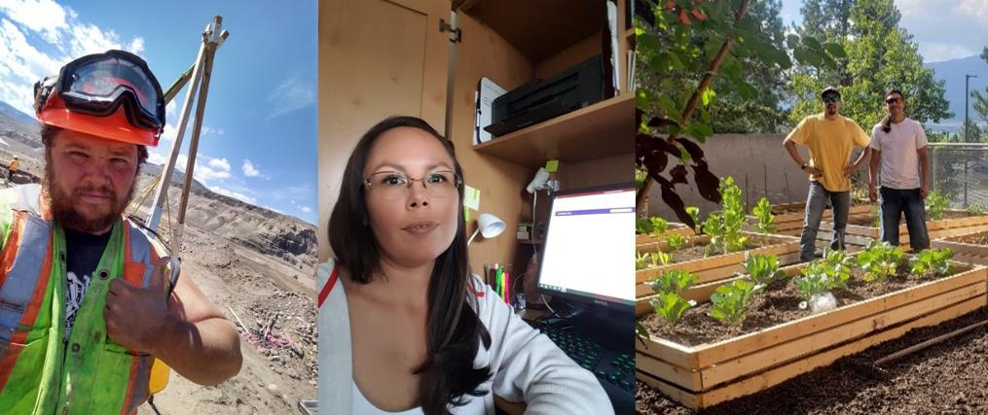
COOPERATIVE EDUCATION
Reflect & Connect Education with Experience

Slide 2
COOPERATIVE EDUCATION Learning Beyond the Classroom
Connects students with relevant, paid work experience
Alternates between academic semesters and paid work terms
Includes a career preparation class prior to work
Gives students extra credit for work terms and career preparation
Get Paid | Gain Work Experience | Build Your Network Test Drive Your Future

Slide 3
COOPERATIVE EDUCATION Learning Beyond the Classroom
Chanel Robertson, ENRT Student
LeSandra Archachan, Business Student
Get Paid | Gain Work Experience | Build Your Network Test Drive Your Future

Slide 4
COOPERATIVE EDUCATION Learning Beyond the Classroom
The Co-op student work placement program is a spectacular way to solidify academic knowledge, as well as adding a few more school credits to your transcript.
While working at NVIT, I was fortunate to have had opportunities like electrofishing and data collection.
My work experience helped me hone my time management, problem-solving, safety, and peer relationship skills.
Jerome Abbott, ENRT Student
Get Paid | Gain Work Experience | Build Your Network Test Drive Your Future

Slide 5
COOPERATIVE EDUCATION Testimonials
“It changed my life!” ~ Jonathon N.
“Co-op has given me the opportunity to work as an Indigenous summer intern for RBC! It was a great experience and, a way to build a strong network across Canada.” ~ LeSandra A.
"I feel so fortunate to have had this work term, I couldn’t have asked for a more perfect starting point for furthering my forestry career." ~ Andrew J.
“The co-op program has made it possible for me to achieve my goal of employment. In my work term through co-op, I have gained significant self-confidence in myself and at my job.” ~ Shannon V.

Slide 6
COOPERATIVE EDUCATION Apply Now!
Make an appointment to chat with the co-op coordinator before October 22 and receive a $20 gift card.

Slide 7
Questions?
Margaret Hohner
mhohner@nvit.ca

